Slide 1
Linux Basics PGCP-VLSI Linux Shell Scripting & Python Mr. Mukund Waghmare – HPC/AI Engineer – CDAC Noida

Slide 2
Operating System Fundamentals
What is an Operating System?
An OS is system software that:
Manages CPU (Process Management)
Manages Memory (RAM allocation)
Manages File System
Manages I/O Devices
Provides User Interface (CLI/GUI)

Slide 3

What is Linux?
Linux is a Unix-like, open-source operating system
Released in 1991 by Linus Torvalds
Kernel-based architecture
Multi-user, multi-tasking, secure
GNU + Linux
GNU → Utilities
Linux → Kernel
Together → GNU/Linux

Slide 4
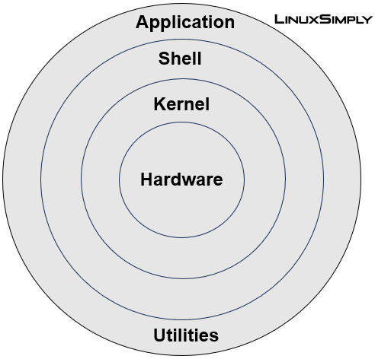
Linux Architecture
Components:
Hardware
Kernel
Process scheduling
Memory management
Device drivers
Shell
Command interpreter
Applications
Note: Shell translates human-readable commands into kernel-understandable instructions.

Slide 5
Important Features of Linux
Open source
Portable
Multi-user
Multi-tasking
Strong CLI
Secure permission model
Powerful networking
Stability for servers
Why Linux in VLSI?
Toolchains (EDA tools)
Server-based workflows
Automation scripting

Slide 6
Linux File System Hierarchy
Linux follows a Single Root Directory Structure
Everything starts from: /
Important directories
Directory | Purpose
/ | Root
/bin | User commands
/sbin | System commands
/etc | Configuration files
/home | User directories
/var | Log files
/tmp | Temporary files
/boot | Boot loader
/dev | Devices
/usr | User software

Slide 7
Basic Navigation Commands
pwd – Print working directory
cd – Change directory
ls – List files
mkdir – Create directory
rmdir – Remove empty directory

Slide 8
File Creation & Viewing Commands
touch – Create empty file
cat – Display file content
head – First 10 lines
tail – Last 10 lines
file – File type

Slide 9
Copy & Move Commands
cp – Copy files
mv – Move/Rename files
rm – Remove files
rm -rf – Force remove
Wildcards:
* → multiple characters
? → single character
Example:
ls file* ls file?

Slide 10
VI Editor
Modes
Command Mode
Insert Mode
Last Line Mode
Basic Operations
Enter insert:
i
Save:
:w
Quit:
:q
Save & Exit:
:wq
Force Quit:
:q!

Slide 11
Create a New User
Syntax:
useradd username
Example:
sudo useradd neha
After creation, home directory is created in:
/home/neha
Verify:
cat /etc/passwd | grep neha
Set / Change Password
Syntax:
passwd username
Example:
sudo passwd neha
Password is stored (encrypted) in:
/etc/shadow

Slide 12
Search & Pattern Matching
grep (Pattern Search)
Syntax:
grep [options] pattern filename
Examples:
grep root /etc/passwd grep -i linux file.txt grep -r "main" .
With Pipe:
cat /etc/passwd | grep bash
find Command
find /home -name "file1" find . -type f -name "*.txt"

Slide 13
File Permissions
Each file has:
Owner
Group
Others
Permission Bits
Example:
rwxr-xr-- → 754
Viewing Permissions
ls -l file1
Output format:
-rwxr-xr-- 1 user group size date file1
Symbol | Value
r | 4
w | 2
x | 1

Slide 14
chmod
Numeric Method
Example:
chmod 755 file1 chmod 644 file1
Meaning:
7 → rwx 5 → r-x 4 → r--
Symbolic Method
chmod [ugoa][+/-][rwx] filename
Examples:
chmod o+w file1 chmod g-x file1 chmod u+rwx file1

Slide 15
chown & chgrp
Change Owner
chown user file chown user:group file
Example:
chown neha file1 chown neha:neha file1
⚠ Only root can change ownership.
Change Group
chgrp group file

Slide 16
Access Control List (ACL)
Used when permission needs to be given to specific user only
Set ACL
setfacl -m u:username:permission filename
Example:
setfacl -m u:ron:rwx file1
Recursive ACL
setfacl -R -m u:ron:rwx folder
View ACL
getfacl filename

Slide 17
UMASK
umask is a mask value that removes permissions from the default.
It defines what permissions should NOT be given.
Formula:
Effective Permission = Default – Umask
Default permissions:
File → 666
Directory → 777
Effective permission:
Default – Umask
Example:
666 – 022 = 644
Check:
umask stat -c %a file

Slide 18
Sticky Bit
Applied on directories.
Only file owner can delete file.
Apply Sticky Bit
chmod +t folder
Check
ls -ld folder
Output:
drwxrwxr-t
T indicates sticky bit.

Slide 19
Remote Commands
SSH
ssh user@ip
SFTP
sftp user@ip
FTP
ftp ip_address

Slide 20
Mount & Unmount
Attach storage:
mount /dev/sdb1 /mnt
Detach:
umount /mnt
Used for:
USB
External storage
Network drives

Slide 21
Lab Practice Tasks
Create 3 users
Create shared directory
Apply permissions
Apply ACL
Apply sticky bit
Search users with bash shell
Edit files using vi

Slide 22
